Slide 1
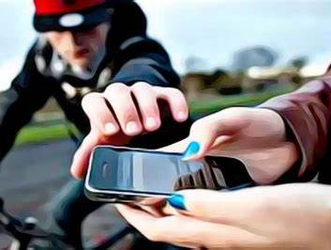
Criminals are using bicycles, mopeds and e-scooters to snatch mobile phones.
Protect yourself and your property
Don’t text while walking
Be aware of your surroundings
Go hands free
Plan your journey in advance
Have a written record of your IMEI number
Register your device on www.immobilise.com
Scan QR code for more crime
advice

